Slide 1
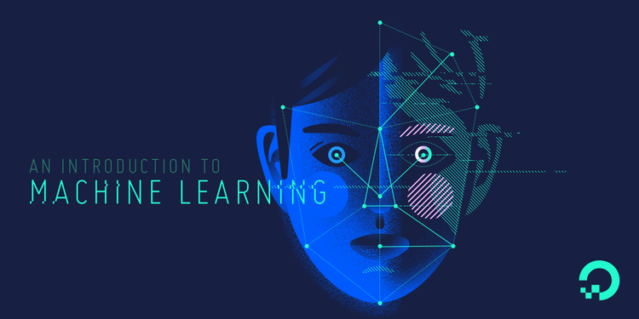
As a part of the assigned work for this course, we are requiring you to complete a project of your own choosing that is based on: Convolutional Neural Networks (CNNs) “Automatic Character Identification From Video”
CSE-465 Pattern Recognition & Neural Networking

Slide 2
DESCRIPTION
This work aims to realize a recognition system for a software engine that will automatically detect character using
Convolutional Neural Networks (CNNs) from a video content. Our system actually includes tracking a certain character from any content like TV show, cinema, or any other source and to count the character frame time. The main part of our work is to detect and identify faces/character from any series movies. Identification of characters in films, although very intuitive to humans, still poses a significant challenge to computer methods. Now a day’s character Identification from films is a very challenging task due to the huge variation in the appearance of each & every character. It will lead significant research interests and may have many interesting applications in today’s life. It is a challenging problem due to the huge variation in the appearance of each character. In particular, character identification for movie used video and script. Face tracking and clustering from video and name of person extract from script. Many challenges for face clustering and face-name matching are present. In good situation and clean environment existing methods gives better result, but in a complex movie scene performance is limited because face tracking and clustering process generate a noise. This task is challenging since characters present significant variation in their appearance.

Slide 3
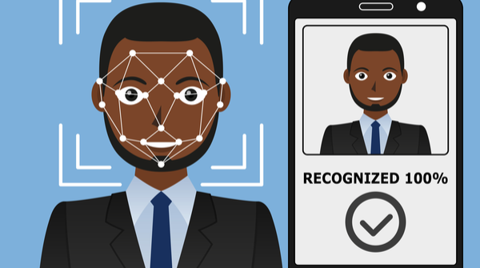
The face recognition Library:
In order to perform face recognition with Python and OpenCV we need to install two additional libraries:
Dlib: The dlib library, contains our implementation of “deep metric learning” which is used to construct our face embedding's used for the actual recognition process.
The face_recognition: face_recognition library wraps around dlib’s facial recognition functionality, making it easier to work with.

Slide 4
LIBARIES THAT WE HAVE USED
For the face recognition in both images and video we have used:
OpenCV
Numpy
Keras
Python
Skimage
Deep learning
Dataset:
Face recognition dataset was created programmatically with Python and the Bing Image Search API.

Slide 5
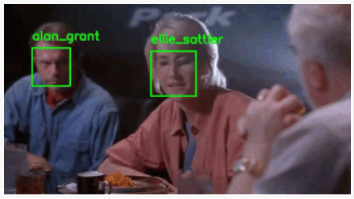
CHARACTER RECOGNITION FROM VIDEO
Face recognition in video streams using Python and OpenCv

Slide 6
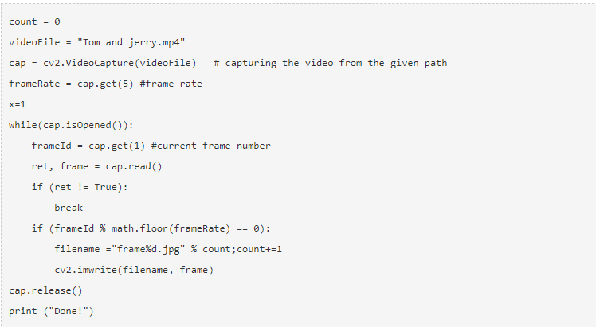
UPDATE
So the character screen time is calculated in the following way:
Step 1: Read the video, extract frames from it and save them as images:
At first we captured the video from the given directory using the VideoCapture() function, and then we have extract frames from the video and save them as an image using the imwrite() function.

Slide 7
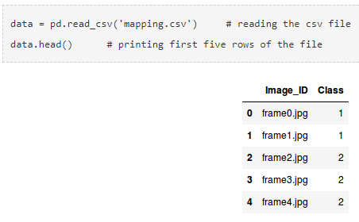
Step 2: Label a few images for training the model:
We have manually given labels to a few of the images and train the model on them.
There could be frames when neither TOM nor JERRY are present. So, we will treat it as a multi-class classification problem. The classes which I have defined are:
0 – neither JERRY nor TOM
1 – for JERRY
2 – for TOM
The mapping file contains two columns:
Image_ID: Contains the name of each image.
Class: Contains corresponding class for
for each image.

Slide 8
Step 3: Building the model
We used VGG16 pretrained model which takes an input image of shape (224 X 224 X 3).
Since our images are in a different size, we need to reshape all of them. We will use the resize() function of skimage.transform to do this.
We have divided into 3 sub-steps to build the model:
Building the model.
Compiling the model.
Training the model.

Slide 9

Step 4: Make predictions for the remaining images
Step 5 Calculate the screen time of both TOM and JERRY Character from video
And there we have found the total screen time of both TOM and JERRY from the video.

Slide 10
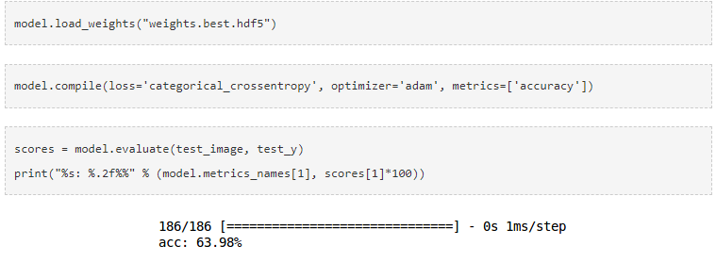
ACCURACY
I got an accuracy of around 64% on the test data using the model.

Slide 11
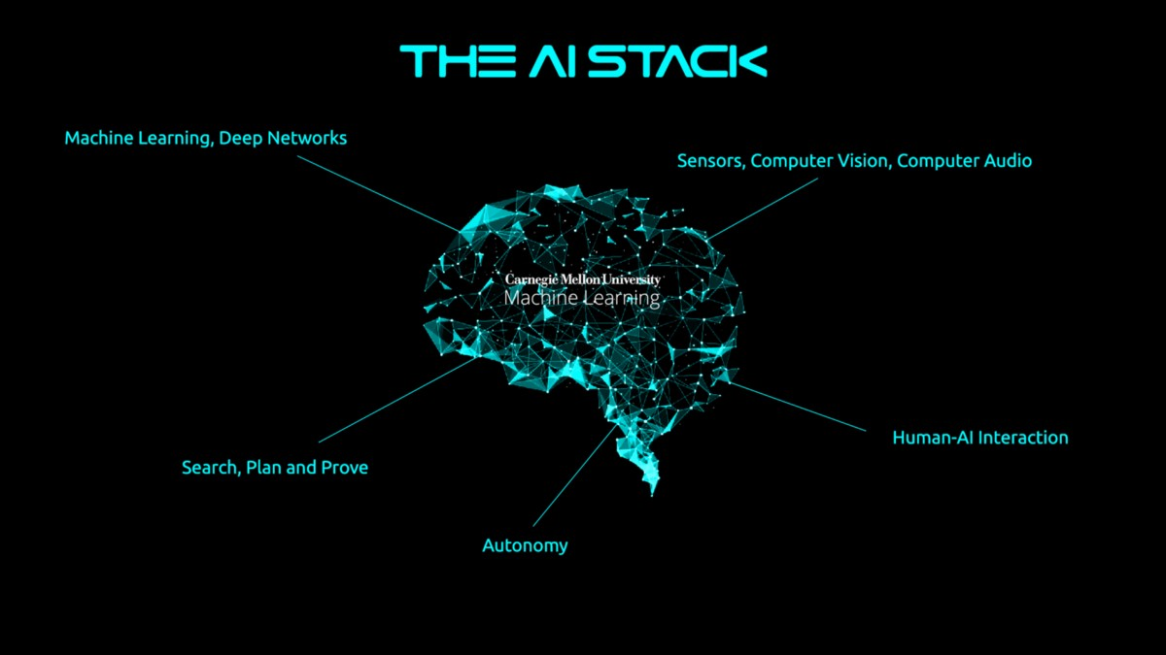
Thank You!!

